Slide 1
Prsentation on Digital Marketing
Prepared by: Presented to:
Group 'I' Saroj Dhital
Umesh Giri
Bhisan Dulal
Rebecca Swar
Chandra bhandari

Slide 2
Content
1.Introduction
2.Types
3.Advantage
4.Disadvantage
5.Conclusion

Slide 3
What is digital marketing?
Today’s time of Internet has opened the gateway of tremendous digital marketing opportunities for businesses. By utilizing different channels of digital marketing, businesses cannot just share their product and services online; additionally they can gain clients for their business, entice them and can convert them to boost their ROI. The speed and straightforwardness with which the digital media transmits data and support a business is astonishing. In this Introduction to Digital Marketing E-Guide, every single aspect of Digital Marketing will be discussed to help marketers understand what Digital Marketing is, how it functions, and how it can help them optimize their marketing campaign.
The world is super-connected nowadays and all things considered, marketing and advertising are no more the same as they once were. This is particularly valid because of the ascent of online networking, which has changed how organizations speak with potential and
existing customers.

Slide 4
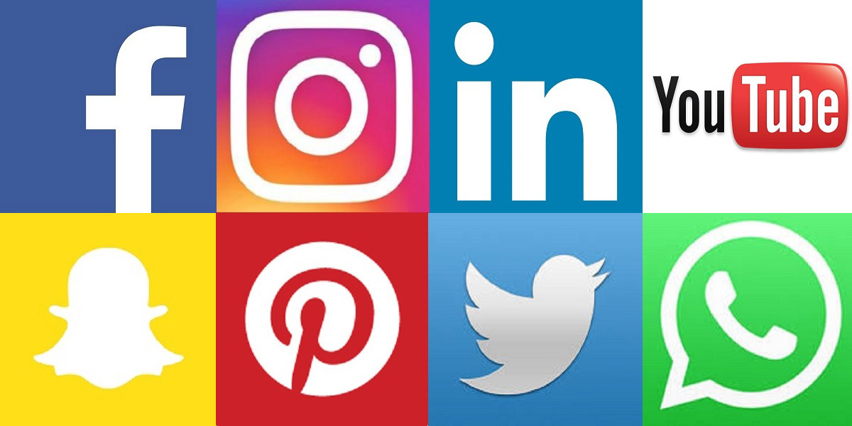
Types or measures of digital marketing
Marketing through social media:
Social media marketing is a powerful way for businesses of all sizes to reach prospects and customers. Your customers are already interacting with brands through social media, and if you're not speaking directly to your audience through social platforms like Facebook, Twitter, Instagram, and Pinterest, you're missing out! Great marketing on social media can bring remarkable success to your business, creating devoted brand advocates and even driving leads and sales.

Slide 5
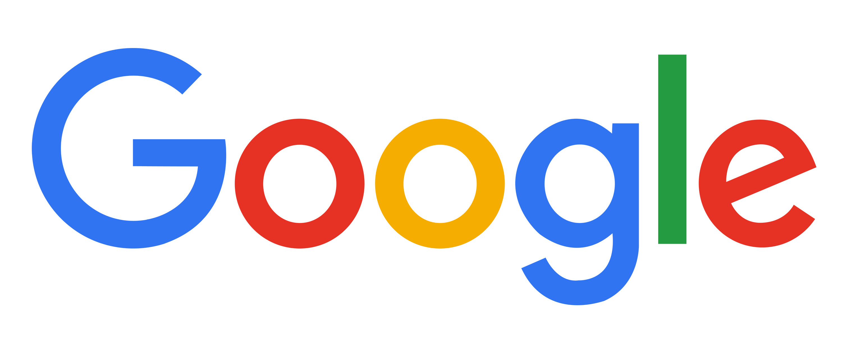
Search Engine Optimization
Search engine optimization (SEO) has come a long way since it originated around 1991. The search engine plays a vital role in everyone’s lives nowadays.
In the world of marketing, SEO is still a large investment of time and resources. And for good reason – buyers tend to rely on search engines to learn more about their problems and to better understand their available solutions.As a content marketer, you need to understand why SEO still matters, how your content creation and SEO affect one another, how to build SEO strategies, and so much more.
If you’re a novice looking to learn all things SEO or an expert hoping to brush up on the most up-to-date information, you’re in the right place.This is the ultimate guide to SEO for content marketers

Slide 6
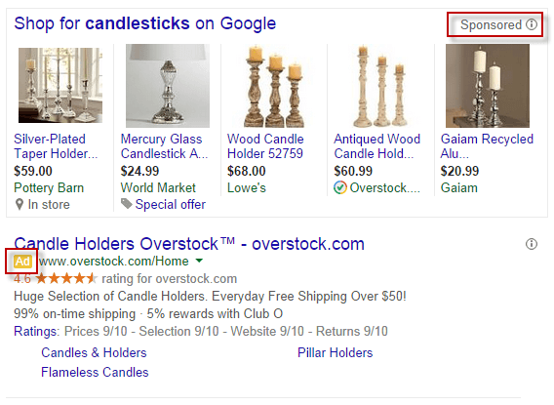
Pay Per Click (PPC)
PPC stands for pay-per-click, a model of internet marketing in which advertisers pay a fee each time one of their ads is clicked. Essentially, it’s a way of buying visits to your site, rather than attempting to “earn” those visits organically.
Search engine advertising is one of the most popular forms of PPC. It allows advertisers to bid for ad placement in a search engine's sponsored links when someone searches on a keyword that is related to their business offering. For example, if we bid on the keyword “PPC software,” our ad might show up in the very top spot on the Google results page.

Slide 7

Marketing through websites
Web marketing is the process of using the Internet to market your business. It includes the use of social media, search engines, blogging, videos, and email.Promoting a business takes effort. There are a variety of ways to do it. Traditional advertising in newspapers, on the radio and television, direct mail, and billboards has been around for decades.
Web marketing takes your message to the big wide web. With tons of people using the internet every day, there are huge opportunities to get your product or service in front of people who need or want it.Drilling down into it, web marketing takes many forms. Banner ads, email promotions, and social media posting are three of the ones you have probably heard about. They, and more, live under the “web marketing” umbrella.
example:

Slide 8
Advantage
Reach Global - a website allows you to find new markets and trade globally for only a small investment.
Lower cost - a properly planned and well targeted digital marketing campaign can reach the right customers at a much lower cost than traditional marketing methods.
Trackable, measurable results - measuring your online marketing with web analytics and other online metric tools makes it easier to establish how effective your campaign has been. You can obtain detailed information about how customers use your website or respond to your advertising.
Personalisation - if your customer database is linked to your website, then whenever someone visits the site, you can greet them with targeted offers. The more they buy from you, the more you can refine your customer profile and market effectively to them.
Openness - by getting involved with social media and managing it carefully, you can build customer loyalty and create a reputation for being easy to engage with.
Social currency - digital marketing lets you create engaging campaigns using content marketing tactics. This content (images, videos, articles) can gain social currency - being passed from user to user and becoming viral.
Improved conversion rates - if you have a website, then your customers are only ever a few clicks away from making a purchase. Unlike other media which require people to get up and make a phone call, or go to a shop, digital marketing can be seamless and immediate.

Slide 9
Disadvantage
Skills and training – You will need to ensure that your staff have the right knowledge and expertise to carry out digital marketing with success. Tools, platforms and trends change rapidly and it’s vital that you keep up-to-date.
Time consuming – tasks such as optimising online advertising campaigns and creating marketing content can take up a lot of time. It’s important to measure your results to ensure a return-on-investment.
High competition – while you can reach a global audience with digital marketing, you are also up against global competition. It can be a challenge to stand out against competitors and to grab attention among the many messages aimed at consumers online.
Complaints and feedback – any negative feedback or criticism of your brand is can be visible to your audience through social media and review websites. Carrying out effective customer service online can be challenging. Negative comments or failure to respond effectively can damage your brand reputation.
Security and privacy issues – there are a number of legal considerations around collecting and using customer data for digital marketing purposes. Take care to comply with the rules regarding privacy and data protection.

Slide 10
Conclusion
With the help of digital marketing seller can advertise its product through different sources.there is advanced profit in its sector rather then traditional marketing if gone with different tactis.noawadays people buy and sell product online so digital marketing is increasing day by day.there is career in this field as well. you have to be competitive in this field to become sucessful.
sources:
hubspot,businessinfo.uk,wordstream.

Slide 11


Thank you

